Slide 1
Washington Energy Decarbonization Examination
Public Technical Meeting 4

Slide 2
Welcome + Introductions
Notes:
Sam will open the meeting with a welcome and pass to the Commissioners for brief remarks. Other legislators and members of Tribes who are in attendance will be acknowledged.
The SSG team will then introduce themselves. SSG will ask for participant intros in the chat.

Slide 3
Meeting Operating Guidelines
Let’s share airtime in order to listen to, and hear from, as many perspectives as possible.
Let’s manage our participation together to start and end on time.
Let’s use respectful and inclusive language.

Slide 4
Zoom Etiquette
Please stay on mute when not speaking, and use the chat to ask questions, while presentations are in-progress.
Please use the “raise hand” function to ask a question during Q+A periods, and let us know your name and affiliation (if you have one).
Please note that we are recording this session.

Slide 5
Agenda
Introduction
Project Overview
Equity Considerations
Co-benefits and co-harms
Feedback Lab
Next Steps

Slide 6
Project Overview

Slide 7
Why is the Commission undertaking this examination?
Senate Bill 5092, section 143 provided funding for the Commission to:
“examine feasible and practical pathways for investor-owned electric and natural gas utilities to contribute their share to greenhouse gas emissions reductions as described in RCW 70A.45.020, and the impacts of energy decarbonization on residential and commercial customers and the electrical and natural gas utilities that serve them.”
RCW 70A.45.020 states that Washington shall limit anthropogenic emissions of greenhouse gases (GHGs) as follows:
(i) By 2020, reduce GHGs to 1990 levels, or 90.5 million metric tons;
(ii) By 2030, reduce GHGs to 50 million metric tons, or 45% below 1990 levels;
(iii) By 2040, reduce GHGs to 27 million metric tons, or 70% below 1990 levels;
(iv) By 2050, reduce GHGs to 5 million metric tons, or 95% below 1990 levels.

Slide 8
Senate Bill 5092, section 143 requirements
The examination must identify and consider:
“(i) How natural gas utilities can decarbonize;
(ii) The impacts of increased electrification on the ability of electric utilities to deliver services to current natural gas customers reliably and affordably;
(iii) The ability of electric utilities to procure and deliver electric power to reliably meet that load;
(iv) The impact on regional electric system resource adequacy, and the transmission and distribution infrastructure requirements for such a transition;
(v) The costs and benefits to residential and commercial customers, including environmental, health, and economic benefits;
(vi) Equity considerations and impacts to low-income customers and highly impacted communities; and
(vii) Potential regulatory policy changes to facilitate decarbonization of the services that gas companies provide while ensuring customer rates are fair, just, reasonable, and sufficient.”
Notes:
I - according to BAP, there would be this must NG demand left in the system - need to provide in alt fuels, or decrease NG demand - that’s going to vary scenario to scenario
II - Set up what electricity demand looks like in BAP, or decarb scenarios - this is the demand that you have to meet
III - Use Power council results that were found to be reliable and comprehensive and see how our projected demand fits within their projections, any gaps are the needs for electric power
IV - rolled into power council results; trade between Balancing Authorities will show what it looks like in 2019; then we can do a similar analysis into the future to what it could look like under decarb scenarios
V - VII - this is part of our decarb scenario - framing; also
VII - working with the Regulatory Assistance Project and identifying best practices

Slide 9
What are we working on together?
By June 1, 2023, the Washington Utilities and Transportation Commission will use the Energy Decarbonization Pathways Examination to report to the legislature on “feasible and practical pathways for investor-owned electric and natural gas utilities to contribute their share to greenhouse gas emissions reductions as described in RCW 70A.45.020, and the impacts of energy decarbonization on residential and commercial customers and the electrical and natural gas utilities that serve them.”^{[1]}
The legislature will use this information to inform discussions on decarbonization targets and policies for investor-owned natural gas utilities.
This project is about identifying and describing the various pathways to achieve a certain level of natural gas emissions reduction. This project is not about choosing one pathway.
^{[1]} Senate Bill 5092 Section 143.4.

Slide 10
Scenarios

Slide 11
Common Actions
Energy Reduction
Maximum mode shifting | Shift to higher density residences in urban zones
Deep retrofits in the building stock | Efficiency improvements in industry
Efficiency improvements in the building stock

Slide 12
Low-Carbon Scenarios
Electrification | Alternative Fuels | Hybrid
Rapid electrification of existing residential and commercial heating systems | Existing residential and commercial natural gas heating systems replaced by natural gas heat pumps | Rapid electrification of existing residential and commercial heating systems
Deployment of decentralized solar PV and storage | Adoption of hydrogen into residential homes | Deployment of decentralized solar PV and storage
Increased electrification of commercial transportation | Clean hydrogen and CRNG used in a greater share of commercial transportation | Electrification, clean hydrogen and CRNG in commercial transportation
Electrification of some industrial processes | Industrial processes use clean hydrogen, RNG and other fuels | Industrial processes use clean hydrogen, RNG and other fuels
 | Clean hydrogen and RNG in the natural gas grid | Clean hydrogen and RNG in the natural gas grid

Slide 13
Low-Carbon Scenarios
Scenario 1 In State Constrained | Scenario 2 Imports Constrained
Defined in state capacity | Defined imports
Residual demand is met by imports | Residual demand is met by in state generation

Slide 14
Equity Considerations

Slide 15
Environmental Justice
"Environmental justice" means the fair treatment and meaningful involvement of all people regardless of race, color, national origin, or income with respect to the development, implementation, and enforcement of environmental laws, rules, and policies.
Source: Healthy Environment for All (HEAL) Act of 2021
Notes:
The Healthy Environment for All Act (HEAL Act) was passed by the Legislature in 2021. It is the first statewide law to create a coordinated and collaborative approach to environmental justice.
This new law takes a historic step toward making environmental justice a priority and part of the mission of key state agencies. The law requires Ecology and the state departments of Agriculture, Commerce, Health, Natural Resources, Transportation, and the Puget Sound Partnership to identify and address environmental health disparities in overburdened communities and underserved populations. Agencies not covered by the law can choose to opt in.
The purpose of this environmental justice law is to:
Ensure environmental reviews, funding decisions, and permitting decisions identify and address environmental health disparities.
Reduce exposure to environmental hazards on tribal lands.
Track and measure implementation of environmental justice in state agencies.

Slide 16
Environmental Justice
Environmental justice includes addressing disproportionate environmental and health impacts in all laws, rules, and policies with environmental impacts by prioritizing vulnerable populations and overburdened communities, the equitable distribution of resources and benefits, and eliminating harm.
Source: Healthy Environment for All (HEAL) Act of 2021
Notes:
The Healthy Environment for All Act (HEAL Act) was passed by the Legislature in 2021. It is the first statewide law to create a coordinated and collaborative approach to environmental justice.
This new law takes a historic step toward making environmental justice a priority and part of the mission of key state agencies. The law requires Ecology and the state departments of Agriculture, Commerce, Health, Natural Resources, Transportation, and the Puget Sound Partnership to identify and address environmental health disparities in overburdened communities and underserved populations. Agencies not covered by the law can choose to opt in.
The purpose of this environmental justice law is to:
Ensure environmental reviews, funding decisions, and permitting decisions identify and address environmental health disparities.
Reduce exposure to environmental hazards on tribal lands.
Track and measure implementation of environmental justice in state agencies.

Slide 17
Just Transition
“Just Transition” is a principle, a process, and a practice. The principle of just transition is that a healthy economy and a clean environment can and should co-exist. The process for achieving this vision should be a fair one that should not cost workers or community residents their health, environment, jobs, or economic assets.
Source: Just Transition Alliance

Slide 18
Low-income households
"Low-income" means household incomes that do not exceed the higher of eighty percent of area median income or two hundred percent of federal poverty level, adjusted for household size.
Source: Washington Administrative Code 480-109-060, Definitions

Slide 19
Highly Impacted Communities
Highly impacted communities meet at least one of the following two criteria:
The census tract is covered or partially covered by ‘Indian Country' as defined in and designated by statute.
The census tract ranks a 9 or 10 on the Environmental Health Disparities Map, as designated by the Department of Health (DOH).
Source: Washington State Department of Health

Slide 20
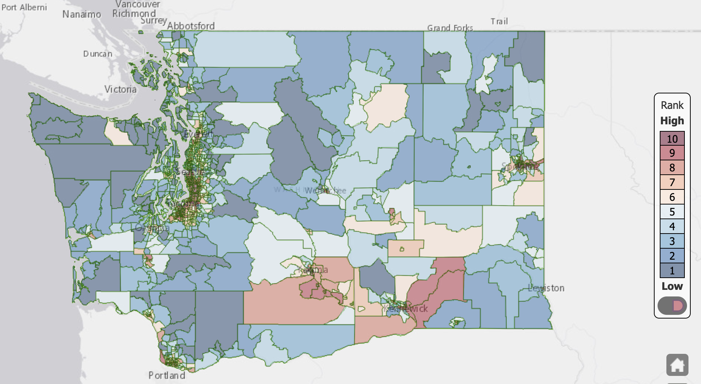
Highly Impacted Communities

Slide 21
Vulnerable Populations
"Vulnerable populations" means communities that experience a disproportionate cumulative risk from environmental burdens due to:
(i) Adverse socioeconomic factors, such as unemployment, high housing and transportation costs relative to income, limited access to nutritious food and adequate health care, and linguistic isolation; and
(ii) sensitivity factors, such as low birth weight and higher rates of hospitalization.
Source: Washington State Legislature

Slide 22
Vulnerable Populations
"Vulnerable populations" includes, but is not limited to:
(i) Racial or ethnic minorities;
(ii) Low-income populations;
(iii) Populations disproportionately impacted by environmental harms; and
(iv) Populations of workers experiencing environmental harms.
Source: Washington State Legislature

Slide 23
Miro Board Exercise

Slide 24
Co-benefits and Co-harms

Slide 25
What are Co-benefits and Co-harms?
In this analysis, co-benefits or co-harms are assumed to be any benefits or harms additional to the impact on GHG emissions
Action Co-benefit Criteria
Synergies - Do actions have multiple benefits
Urgency - A higher degree of urgency in order to avoid loss of inertia on action already taken
Costs - The cost of early action is generally lower than later action
Longevity - Related to urgency, the longevity of investment decisions locks society into their effects
Distribution Effects - Actions have different impacts on different subsets of the population
Notes:
Synergies: Many low carbon actions have multiple socio-economic benefits, including transit, energy efficiency, and compact urban design.
Urgency: Some actions are associated with a higher degree of urgency in order to avoid loss of inertia on action already taken, lock-in effects, irreversible outcomes, or deferred, costs that become elevated as a result of deferment . This may occur with road infrastructure decisions, major ecosystems displacement and urban form. Some low carbon actions require time to realize their effects, making immediate implementation paramount.
Costs: The cost of early action is generally lower than later action, in particular because delayed action involves ongoing investments in infrastructure, activities, and utilities that are higher emitting than would be low carbon solutions. Examples include renewable energy infrastructure, transit, and energy efficiency.
Longevity: Related to urgency, the longevity of investment decisions locks society into their effects for decades, if not centuries.
Distribution effects: Low carbon actions have different impacts on different subsets of the population, including income levels, generations (including future generations) and ethnicities.

Slide 26
Co-benefits and Co-harms
Category | Impact overview | Indicators
1. Health
1.1 Air quality | Improvement in air quality. | Criteria air contaminants
1.2 Physical activity | Increased physical activity. | Walking miles traveled; cycling miles traveled by County
1.3 Noise | Decreased exposure to noise. | Decrease/increase in VMT by County; impact of electric vehicles on noise levels.
1.4 Accessibility | Destinations are more accessible. | Accessibility to destinations and workspaces by active modes or transit
1.5 Buildings | Indoor air quality is improved. | Number of homes/floor area of workplaces retrofit

Slide 27
Co-benefits and Co-harms
Category | Impact overview | Indicators
2. Economic prosperity
2.1 Employment | New employment opportunities are created. Existing employment opportunities are lost. | Jobs created/lost by sector and by county
2.2 Economic development | New economic sectors emerge. Existing sectors are phased out. | Capital expenditures by sector and by county
2.3 Innovation | Decarbonisation policies will stimulate innovation. | Number of new sectors
2.4 Reputation | The reputation of the public and private sector is enhanced. | Value of “green” reputation
2.5 Social capital | Communities are more resilient. | Number of cooperatives or other non-profit organizations formed
2.6 Natural capital | Green spaces are preserved and enhanced. | Energy sprawl/land area required for energy infrastructure Area of land preserved or restored

Slide 28
Co-benefits and Co-harms
Category | Impact overview | Indicators
3. Social equity
3.1 Poverty | Energy efficiency will reduce household building and transportation costs. | Household energy expenditures
3.2 Intergenerational equity and resilience | The burden on future generations is decreased. Stranded costs are avoided by acting quickly where possible. | Social cost of carbon

Slide 29
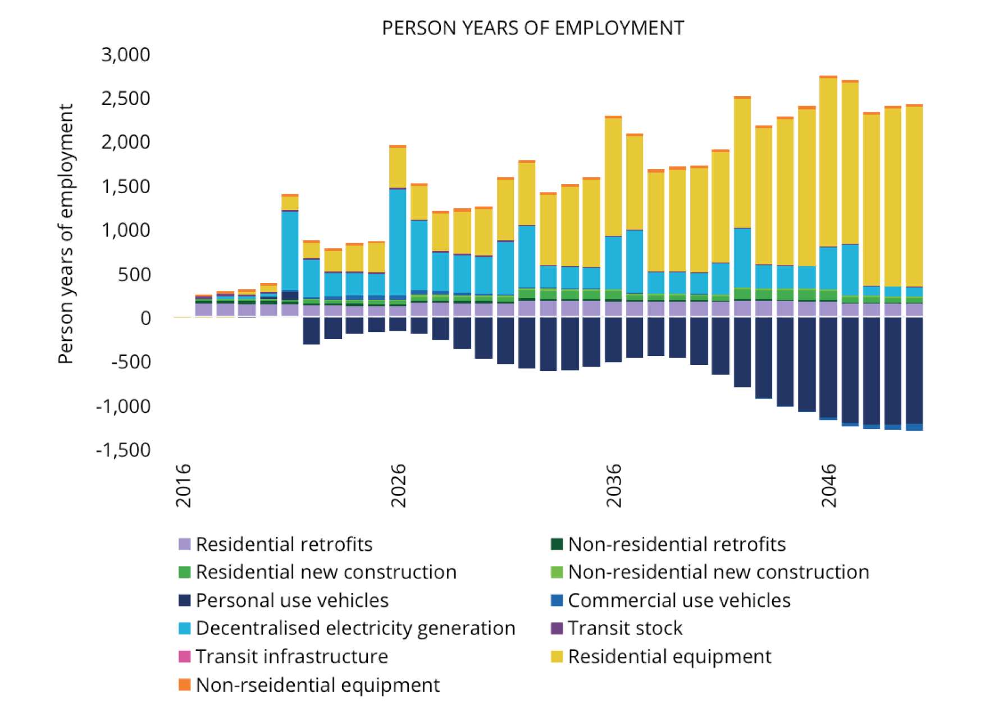
GROWTH
QUALITY GREEN JOBS

Slide 30
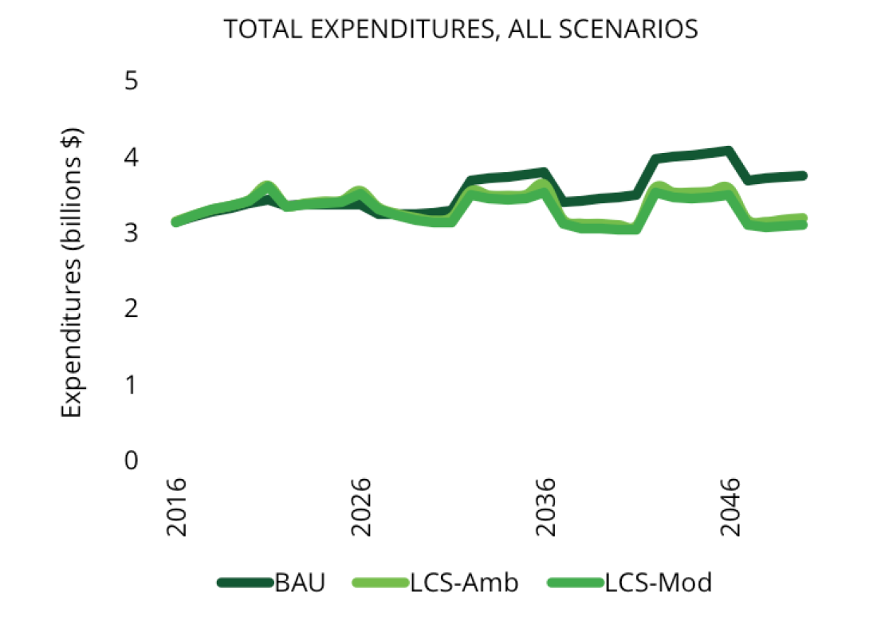
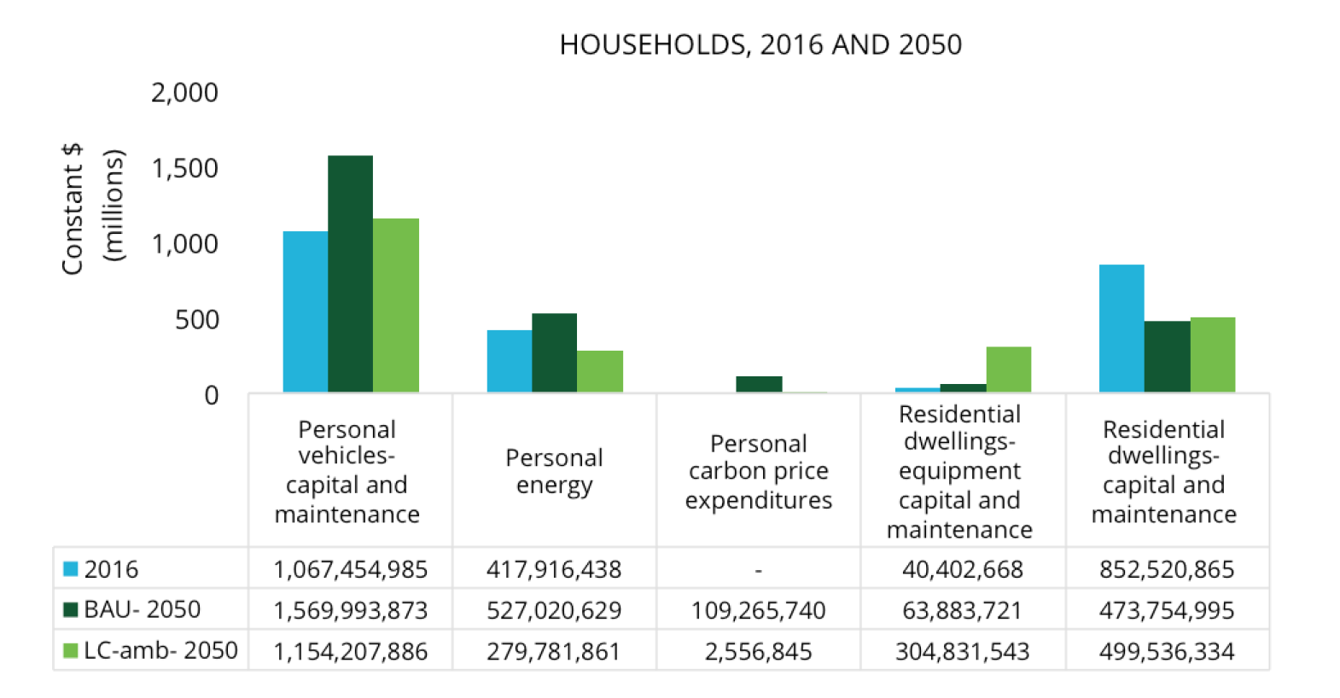
EQUITY
LONG-TERM SAVINGS

Slide 31
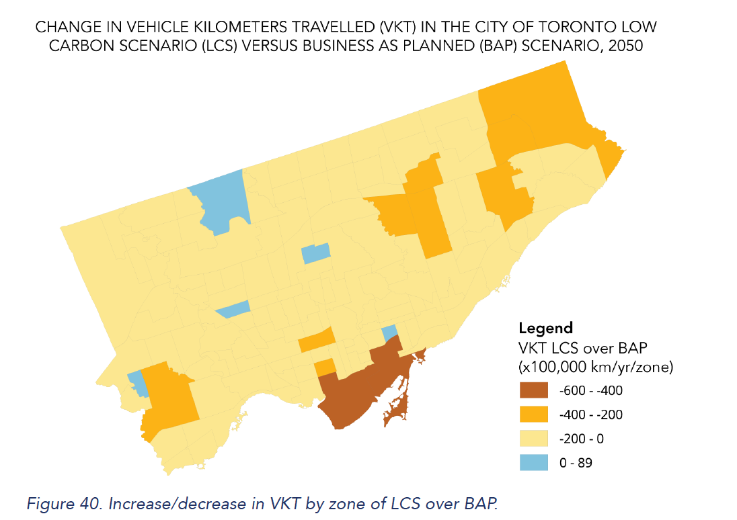
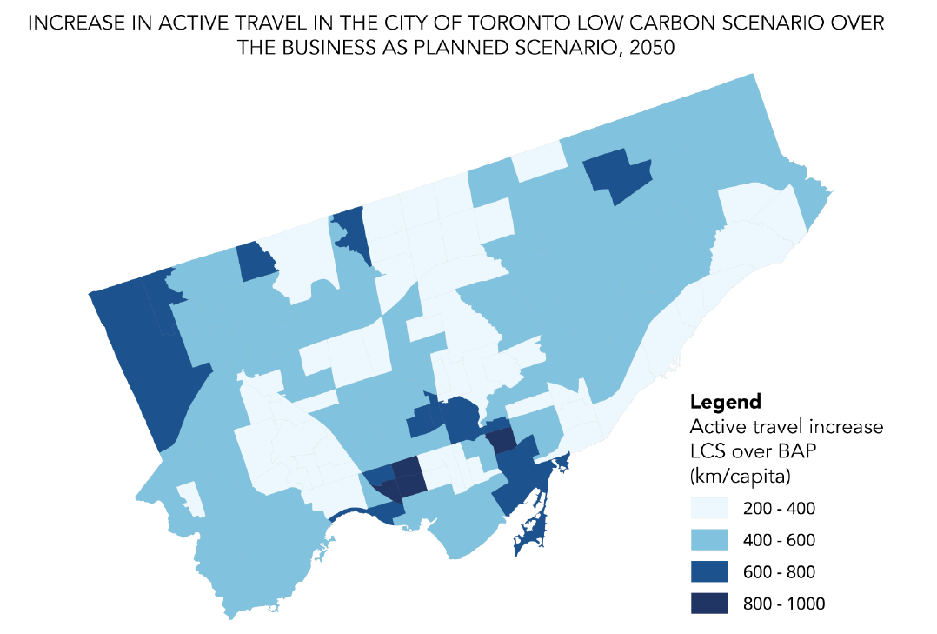
EQUITY
HEALTH + WELL-BEING

Slide 32
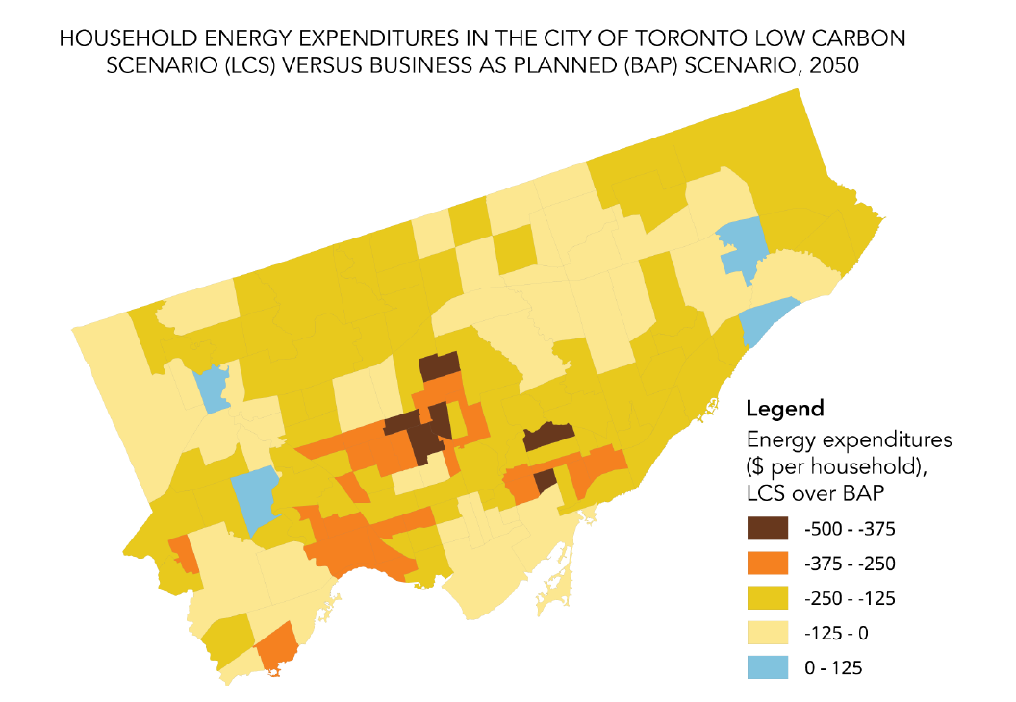
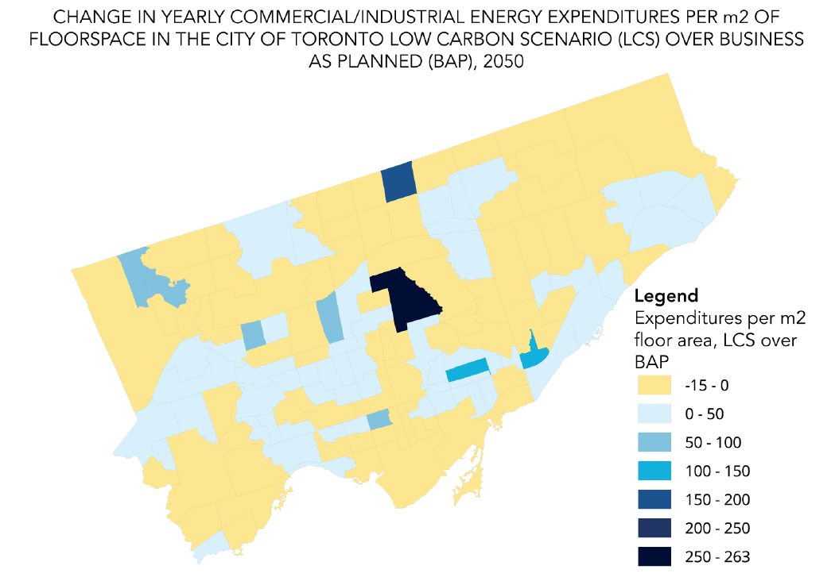
SUSTAINABILITY
AFFORDABILITY

Slide 33
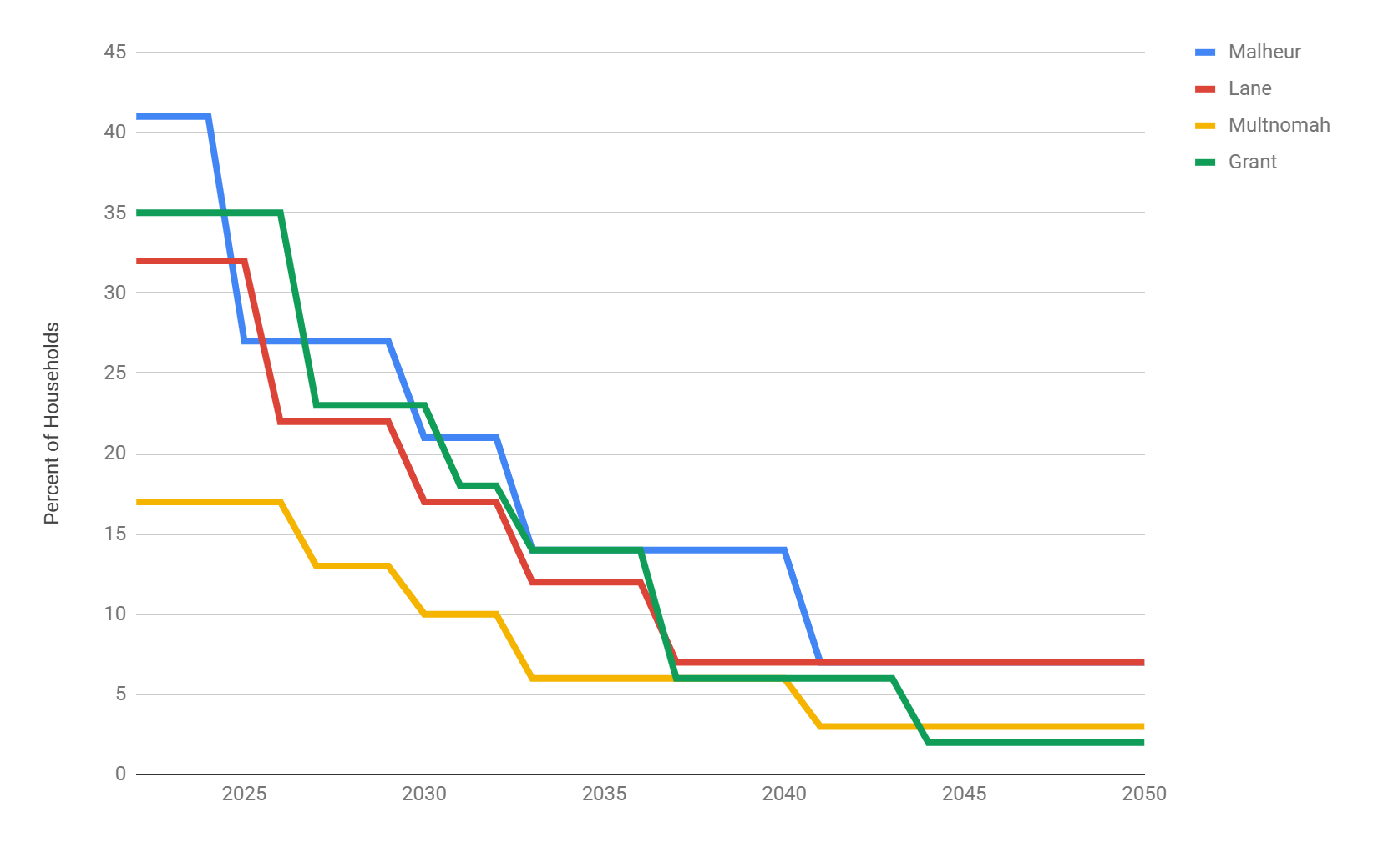
ENERGY BURDEN
AFFORDABILITY
An individual or family is considered energy burdened if they spend 6% or more of their income on energy costs

Slide 34
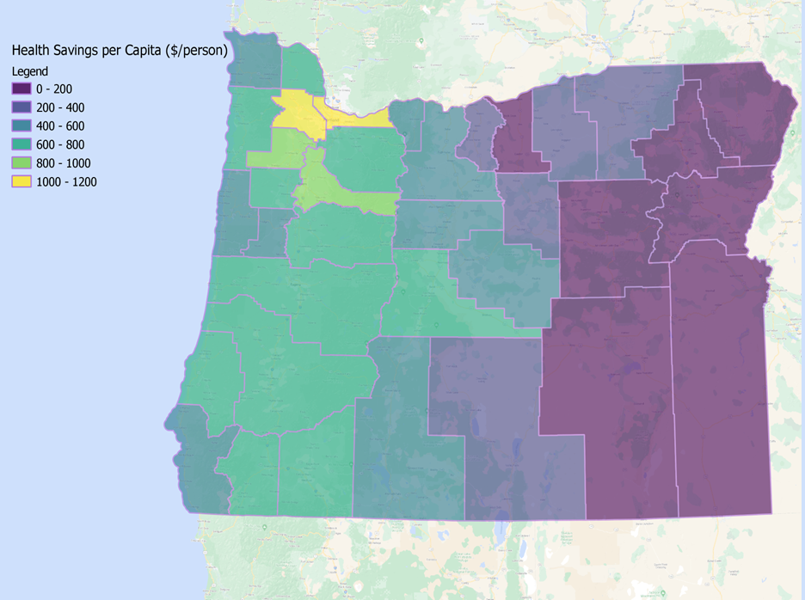
HEALTH
Air Quality
EPA - Benefits Risk Assessment Health Impacts Screening and Mapping Tool (COBRA)

Slide 35
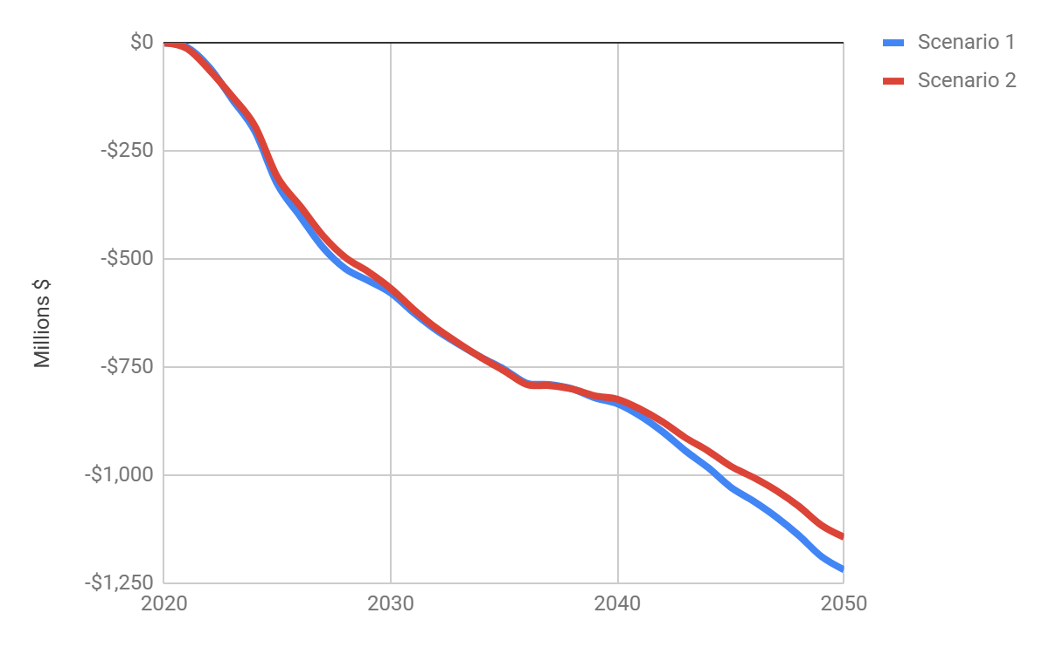
SOCIAL COST OF CARBON
Intergenerational equity and resilience
Economic Impacts of avoided GHG emissions

Slide 36
Co-benefits and Co-harms Q&A

Slide 37
Feedback Lab

Slide 38
Appendix

Slide 39
Miro Board

Slide 40
What does a “just transition” look like for natural gas decarbonization

Slide 41
Common Actions - Both Scenarios
Action | Specification | Which existing policies can support this action | Which new policies can support this action | How might this action affect highly impacted and vulnerable communities
Increase density of development in urban zones | Fraction of single new builds to be reduced to 25% of new buildings in counties with high urban density by 2040, decrease in personal use vehicle miles travelled
Deep retrofits in the building stock | Retrofit 95% of existing buildings by 2040 to achieve a 50% reduction in space heating/cooling and a 40% reduction other non water heating energy use
Increase transit ridership | Triple transit ridership in urban centers by 2040
Decrease freight vehicle miles travelled | Decrease vehicle miles travelled by 15% by 2050

Slide 42
Common Actions - Both Scenarios
Action | Specification | Which existing policies can support this action | Which new policies can support this action | How might this action affect highly impacted and vulnerable communities
Mode Shift to cycling | Transfer 10% of personal use vehicle trips to electric micro-mobility (e.g., e-bike/e-scooter) in urban counties by 2035
Efficiency improvements in industry | Improve the energy efficiency of industrial facilities to achieve a 50% reduction in energy use by 2050
Marine passenger electrification | Passenger ferries 100% electric by 2040

Slide 43
Electrification - Demand Side Actions
Action | Specification | Which existing policies can support this action | Which new policies can support this action | How might this action affect highly impacted and vulnerable communities
Heat pumps residential space conditioning | 95% of new sales for existing buildings are electric heat pumps by 2040
Heat pumps residential water heating | 95% of new sales for existing buildings are electric heat pumps by 2040
Heat pumps commercial space conditioning | 95% of new sales for existing buildings are electric heat pumps by 2040
Heat pumps commercial water heating | 50% of new sales for existing buildings are electric heat pumps by 2040

Slide 44
Electrification - Demand Side Actions
Action | Specification | Which existing policies can support this action | Which new policies can support this action | How might this action affect highly impacted and vulnerable communities
Zero emission commercial use vehicles | Percentage of new sales by 2035 - 100% Classes 2b–3 trucks electric (vans, medium pickup trucks) - 90% Classes 4–8 trucks electric (delivery trucks, delivery/service vans, lighter truck tractors, bucket trucks) - 80% Class 8 truck tractors electric
Electrification of some industrial processes | Deploy electricity in industries - replace 55% fossil fuels with electricity by 2050
Enable distributed energy resources | 20 TWh of rooftop solar PV generation by 2035
Enhance energy storage | Add storage capability to 25% of residential non-apartment building stock by 2035, assume each storage unit is specified to 14 kWh

Slide 45
Alternative Fuels - Demand Side Actions
Action | Specification | Which existing policies can support this action | Which new policies can support this action | How might this action affect highly impacted and vulnerable communities
Heat pumps in residential space conditioning | 95% of new sales for existing buildings are electric & natural gas heat pumps by 2040
Heat pumps in residential water heating | 95% of new sales for existing buildings are electric & natural gas heat pumps by 2040
Heat pumps commercial space conditioning | 95% of new sales for existing buildings are electric and natural gas heat pumps by 2040
Heat pumps commercial water heating | 50% of new sales for existing buildings are electric and natural gas heat pumps by 2040
Adoption of hydrogen into residential homes | Deploy clean hydrogen fuel cells for homes - 5% of homes will have hydrogen fuel cell by 2030

Slide 46
Alternative Fuels - Demand Side Actions
Action | Specification | Which existing policies can support this action | Which new policies can support this action | How might this action affect highly impacted and vulnerable communities
Zero emission commercial use vehicles | Percentage of new sales by 2035 - 100% Classes 2b–3 trucks - 80% EV, 20% ZEV (vans, medium pickup trucks) - 90% Classes 4–8 trucks - 50% EV, 50% ZEV (delivery trucks, delivery/service vans, lighter truck tractors, bucket trucks) - 80% Class 8 truck tractors - 20% EV, 80% ZEV
Hydrogen and RNG into industrial processes | Deploy green hydrogen and RNG in industries - 70% Hydrogen/RNG adoption by 2050
Clean hydrogen in the natural gas grid | New round of standards for appliances and equipment beyond those codified in 2021 - 15% hydrogen injected into the natural gas distribution system by 2035
RNG in the natural gas grid | Use full RNG potential of 87.5 tBTU by 2050

Slide 47
Alternative Fuels - Demand Side Actions
Action | Specification | Which existing policies can support this action | Which new policies can support this action | How might this action affect highly impacted and vulnerable communities
In-state production of RNG | Produce sufficient RNG to provide 6% of RNG demand within the state by 2050
In-state production of clean hydrogen | Produce sufficient hydrogen to provide 50% of hydrogen demand within the state

Slide 48
Hybrid - Demand Side Actions
Action | Specification | Which existing policies can support this action | Which new policies can support this action | How might this action affect highly impacted and vulnerable communities
Heat pumps residential space conditioning | 95% of new sales for existing buildings are electric heat pumps by 2040
Heat pumps residential water heating | 95% of new sales for existing buildings are electric heat pumps by 2040
Heat pumps commercial space conditioning | 95% of new sales for existing buildings are electric heat pumps by 2040
Heat pumps commercial water heating | 50% of new sales for existing buildings are electric heat pumps by 2040
Zero emission commercial use vehicles | Percentage of new sales by 2035 - 100% Classes 2b–3 trucks - 80% EV, 20% ZEV (vans, medium pickup trucks) - 90% Classes 4–8 trucks - 50% EV, 50% ZEV (delivery trucks, delivery/service vans, lighter truck tractors, bucket trucks) - 80% Class 8 truck tractors - 20% EV, 80% ZEV

Slide 49
Hybrid - Demand Side Actions
Action | Specification | Which existing policies can support this action | Which new policies can support this action | How might this action affect highly impacted and vulnerable communities
Hydrogen and RNG into industrial processes | Deploy green hydrogen and RNG in industries - 70% Hydrogen/RNG adoption by 2050
Enable distributed energy resources | 20 TWh of rooftop solar PV generation by 2035
Enhance energy storage | Add storage capability to 25% of residential non-apartment building stock by 2035, assume each storage unit is specified to 14 kWh
Clean hydrogen in the natural gas grid | New round of standards for appliances and equipment beyond those codified in 2021 - 15% hydrogen injected into the natural gas distribution system by 2035
RNG in the natural gas grid | Use full RNG potential of 87.5 tBTU by 2050
In-state production of RNG | Produce sufficient RNG to provide 6% of RNG demand within the state
In-state production of clean hydrogen | Produce sufficient hydrogen to provide 50% of hydrogen demand within the state

Slide 50
Supply Side
Resource | Which existing policies can support this action? | Which new policies could support this action? | How might this action affect highly impacted and vulnerable communities?
Solar
Wind
Hydro
Geothermal
Energy Storage
Hydrogen
RNG
Nuclear
Bioenergy
CCS/CDR

Slide 51
Engagement Review

Slide 52
Engagement in Climate Action Planning
E.
Plan
Financial + Economic Analysis
Health +
Equity
Data
PE
Briefings
Scenarios
Pathways
Iteration + Adaptive Management
Active Engagement Period

Slide 53
Engagement Approach
Overall project will be set involve/collaborate (see next slide) for influence on the decision.
We will ensure a transparent and accessible engagement process.
We will use diverse techniques to effectively reach diverse stakeholders across the state.
We will gather input on the social, economic, and equity impacts of decarbonization actions.
We will design engagements to facilitate collaboration, rather than polarization.

