Slide 1

Washington Energy Decarbonization Examination
Decarbonization Advisory Group Meeting 3

Slide 2


Welcome + Introductions

Slide 3
Meeting Operating Guidelines
Let’s share airtime in order to listen to, and hear from, as many perspectives as possible.
Let’s manage our participation together to start and end on time.
Let’s use respectful and inclusive language.

Slide 4
Zoom Etiquette
Please stay on mute when not speaking, and use the chat to ask questions, while presentations are in-progress.
Please use the “raise hand” function to ask a question during Q+A periods, and let us know your name and affiliation (if you have one).
Please note that we are recording this session.

Slide 5
Agenda
Project Overview - 10 min
Decarbonization Scenarios - 30 min
  preliminary results
  Q&A
Supply and Demand Discussion - 80 min

Slide 6
Today’s To Dos
Here is what we are here to do today
  Review decarbonization projections
    Electricity
    Alternative fuels
    Hybrid
  Gather input into the supply side scenarios
    Constrained in-state production
    Constrained imports

Slide 7
Project Overview

Slide 8
Why is the Commission undertaking this examination?
Senate Bill 5092, section 143 provided funding for the Commission to:
“examine feasible and practical pathways for investor-owned electric and natural gas utilities to contribute their share to greenhouse gas emissions reductions as described in RCW 70A.45.020, and the impacts of energy decarbonization on residential and commercial customers and the electrical and natural gas utilities that serve them.”
RCW 70A.45.020 states that Washington shall limit anthropogenic emissions of greenhouse gases (GHGs) as follows:
(i) By 2020, reduce GHGs to 1990 levels, or 90.5 million metric tons;
(ii) By 2030, reduce GHGs to 50 million metric tons, or 45% below 1990 levels;
(iii) By 2040, reduce GHGs to 27 million metric tons, or 70% below 1990 levels;
(iv) By 2050, reduce GHGs to 5 million metric tons, or 95% below 1990 levels.

Slide 9
Senate Bill 5092, section 143 requirements
The examination must identify and consider:
“(i) How natural gas utilities can decarbonize;
(ii) The impacts of increased electrification on the ability of electric utilities to deliver services to current natural gas customers reliably and affordably;
(iii) The ability of electric utilities to procure and deliver electric power to reliably meet that load;
(iv) The impact on regional electric system resource adequacy, and the transmission and distribution infrastructure requirements for such a transition;
(v) The costs and benefits to residential and commercial customers, including environmental, health, and economic benefits;
(vi) Equity considerations and impacts to low-income customers and highly impacted communities; and
(vii) Potential regulatory policy changes to facilitate decarbonization of the services that gas companies provide while ensuring customer rates are fair, just, reasonable, and sufficient.”

Slide 10
What are we working on together?
By June 1, 2023, the Washington Utilities and Transportation Commission will use the Energy Decarbonization Pathways Examination to report to the legislature on “feasible and practical pathways for investor-owned electric and natural gas utilities to contribute their share to greenhouse gas emissions reductions as described in RCW 70A.45.020, and the impacts of energy decarbonization on residential and commercial customers and the electrical and natural gas utilities that serve them.”^{[1]}
The legislature will use this information to inform discussions on decarbonization targets and policies for investor-owned natural gas utilities.
This project is about identifying and describing the various pathways to achieve a certain level of natural gas emissions reduction. This project is not about choosing one pathway.
^{[1]} Senate Bill 5092 Section 143.4.

Slide 11
What we’ve done so far
What’s coming next
Calibrated the model to 2019 base year
Generated the BAU scenario
Integrated stakeholder feedback into BAP and Decarbonization assumptions
Generated the BAP scenario
Generated base year hourly demand profiles
Compiled base year hourly supply profiles
Generated the Decarbonization scenarios
Generated projected hourly demand profiles
Compiled projected hourly supply profiles
Update Future Load Profiles
Supply Dispatch
Peak Analysis (short and long term)
Sensitivity Analysis
Financial Analysis
Equity and Co-Benefits Analysis

Slide 12
Decarbonization Scenarios

Slide 13
What is Scenario?
A possible future
  It need not be desirable, thus it is not a vision.
  It need not be likely, thus it is not a forecast.
Emphasizes a process of change, not just a point in the future.
Characteristics
Plausible description of a future
Relevant to the key strategic issues and decisions at hand
Challenging to today’s conventional wisdom
Divergent from each other
Balanced

Slide 14
Common Actions
Energy Reduction
Maximum mode shifting | Shift to higher density residences in urban zones
Deep retrofits in the building stock | Efficiency improvements in industry
Efficiency improvements in the building stock

Slide 15
Low-Carbon Scenarios
Electrification | Alternative Fuels | Hybrid
Rapid electrification of existing residential and commercial heating systems | Existing residential and commercial natural gas heating systems replaced by natural gas heat pumps | Rapid electrification of existing residential and commercial heating systems
Deployment of decentralized solar PV and storage | Adoption of hydrogen into residential homes | Deployment of decentralized solar PV and storage
Increased electrification of commercial transportation | Clean hydrogen and CRNG used in a greater share of commercial transportation | Electrification, clean hydrogen and CRNG in commercial transportation
Electrification of some industrial processes | Industrial processes use clean hydrogen, RNG and other fuels | Industrial processes use clean hydrogen, RNG and other fuels
 | Clean hydrogen and RNG in the natural gas grid | Clean hydrogen and RNG in the natural gas grid

Slide 16
Setting Parameters
Install heat pumps for heating system in existing residential buildings
Electrification & Hybrid | Alternative Fuels
Target 100% of existing buildings 80% electric air source 20% electric ground source By 2040 | Target 100% of existing buildings using natural gas 100% natural gas air source By 2040

Slide 17
What we heard - Common Actions
New Buildings
Consider requiring new builds to meet Passive House standards sooner than 2035. Response: this is already being met in the BAP
Building Retrofits
Retrofitting existing buildings makes sense since new buildings are already so energy efficient
Consider the noise impacts of heat pumps and similar equipment
Proposed actions will result in healthier homes and businesses
Funding for retrofits and equipment is a potential barrier to implementation
Concern about whether pace of retrofits is achievable

Slide 18
What we heard - Electrification
Buildings
Consider more aggressive timelines for electrification
Consider constraints such as HOA restrictions, local permitting requirements and electric codes, other upgrades (insulation, wiring, etc.), supply chain
Use local, state, and federal investments and incentives to harness purchasing power for heat pumps and energy efficiency upgrades
Removing gas appliances due to health and safety concerns

Slide 19
What we heard - Electrification
Electricity Demand
Incorporate potential extreme winter peak demands
Include more examination of demand response, controllable load
Electricity Supply
Include examination of the impact of the actions on transmission and distribution capacity
Consider not only traditional batteries at the utility scale but also thermal storage and pumped hydro
Desire to see scenarios that assume no imports

Slide 20
What we heard - Electrification
Equity
Heat pumps will be important to prioritize for vulnerable communities, including BIPOC, lower income, and seniors
Consider the following equity dynamics when proposing implementation of the actions: energy burden (energy poverty), risk, air quality and health, jobs (particularly with trade unions)

Slide 21
What we heard - Alternative Fuels
General
Potential to create jobs and make Washington less reliant on other states for energy
Include out of state sources of alternative fuels
Includes more innovation than Electrification scenario
General support for green hydrogen as an alternative fuel and also for storage and transport of renewable energy
Green hydrogen may be better than batteries for long term storage (summer to winter)
Cost and availability of technology could be an issue

Slide 22
What we heard - Alternative Fuels
Hydrogen
Consider losses incurred by using green hydrogen as electricity storage in comparison to losses from battery storage
Concern about mixing hydrogen in pipelines
Green hydrogen production will require cheap renewable electricity
RNG
Do not use agricultural land for biofuel production
Use RNG in hard to decarbonize sectors - not in buildings
RNG still has the problem of methane leaks
RNG supply may not be sufficient for demand

Slide 23
What we heard - Scenarios
Suggestion to add a third scenario
Inclusion of a hybrid scenario
  Electrification in residential and commercial sectors
  More alternative fuels in industrial and commercial transportation

Slide 24
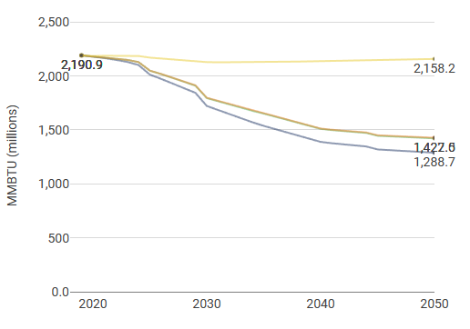
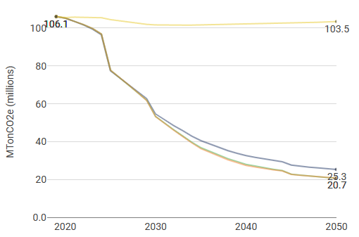

Summary
Energy
Emissions
BAU
Electrification
Alternative Fuels
Hybrid

Slide 25
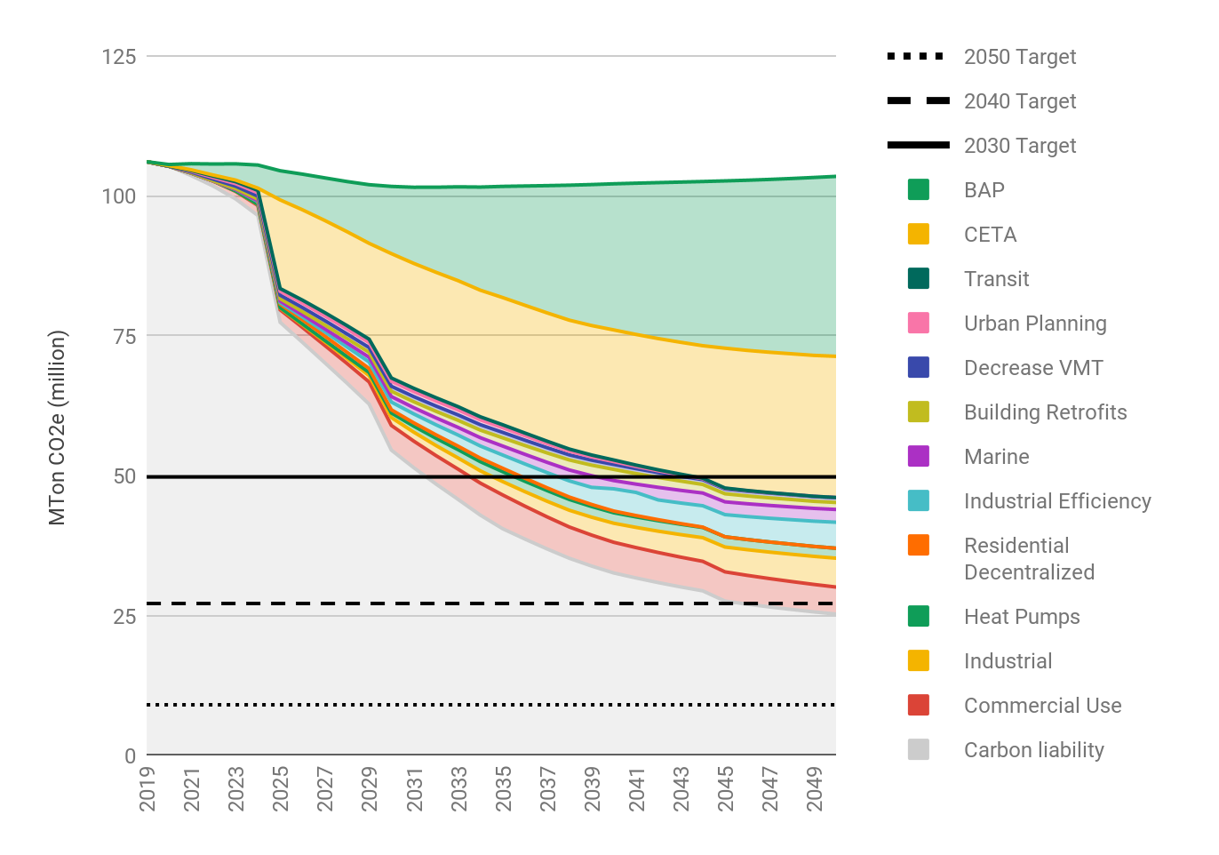
Emission Reduction Wedges
Electrification
Combination of possible policies

Slide 26
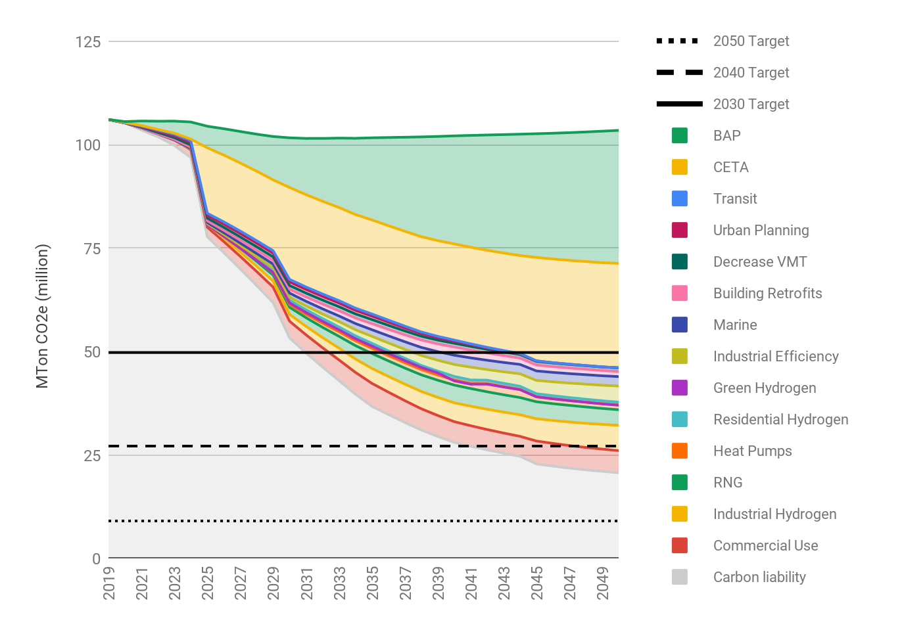
Emission Reduction Wedges
Alternative Fuels
Combination of possible policies

Slide 27

Emission Reduction Wedges
Hybrid
Combination of possible policies

Slide 28
Summary
Energy Use in 2050 - tBTU
 | Electricity | Natural Gas | RNG | Hydrogen | Total
BAP | 394 | 199 | 1.9 | 16 | 611
Electrification | 358 | 69.7 | 1.9 | 13 | 443
Alternative Fuels | 393 | 0.1 | 96 | 161 | 650
Hybrid | 335 | 0.1 | 86 | 159 | 580

Slide 29
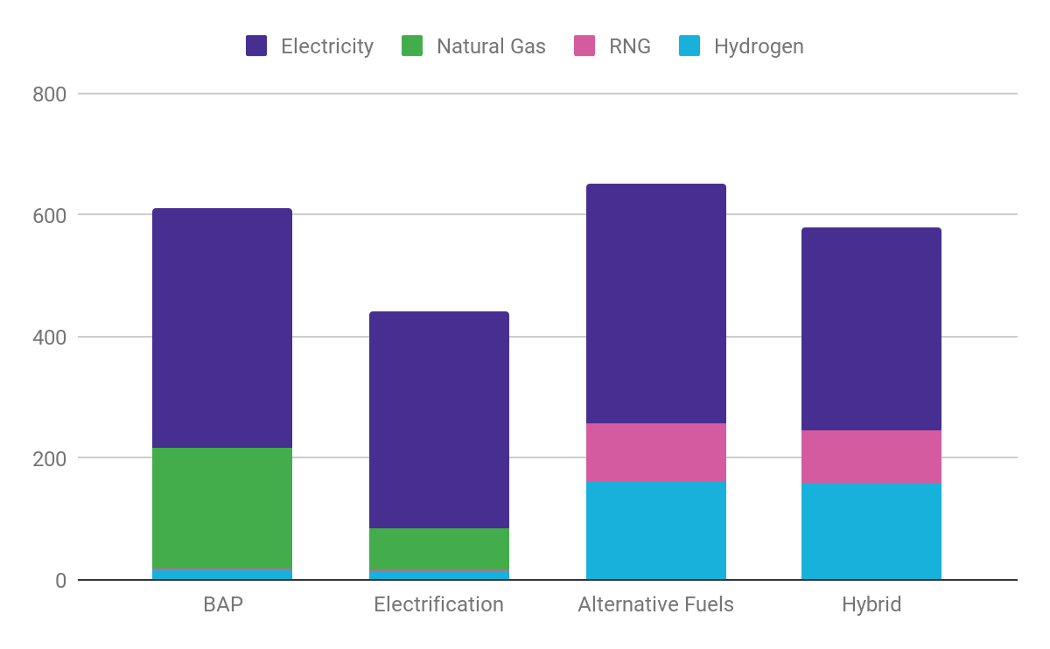
Summary
Energy Use in 2050 - tBTU

Slide 30
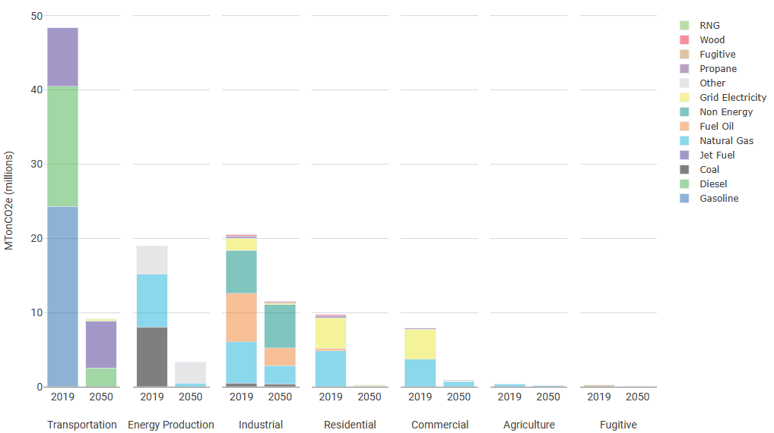
Emissions by Sector and Fuel
Electrification
Natural Gas in Industry

Slide 31
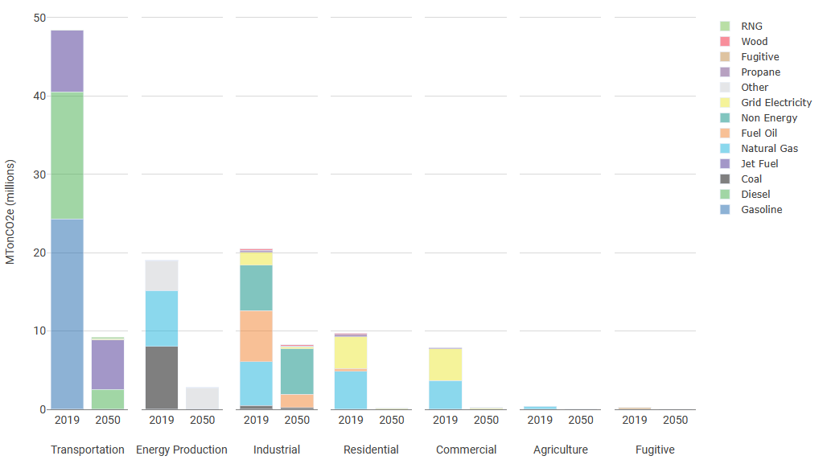
Emissions by Sector and Fuel
Alternative Fuels

Slide 32
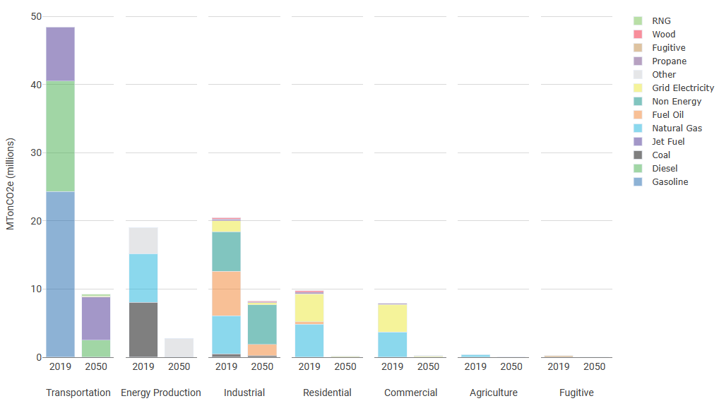
Emissions by Sector and Fuel
Hybrid

Slide 33
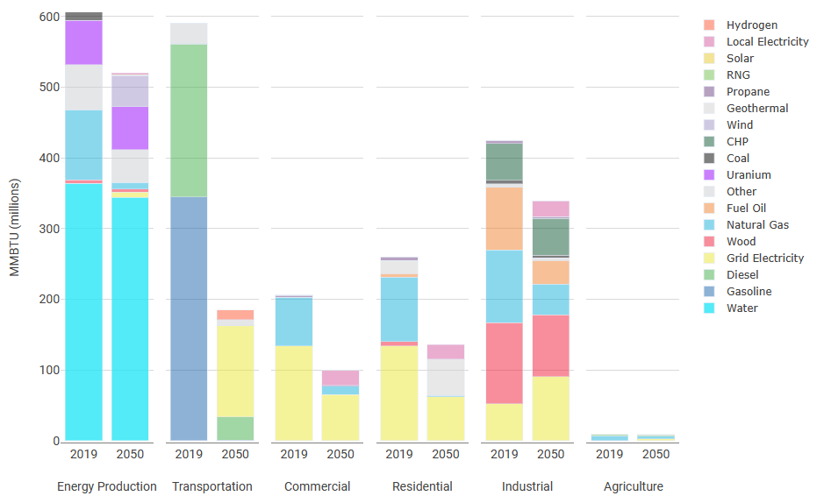
Energy Use by Sector and Fuel
Electrification
Rooftop solar

Slide 34
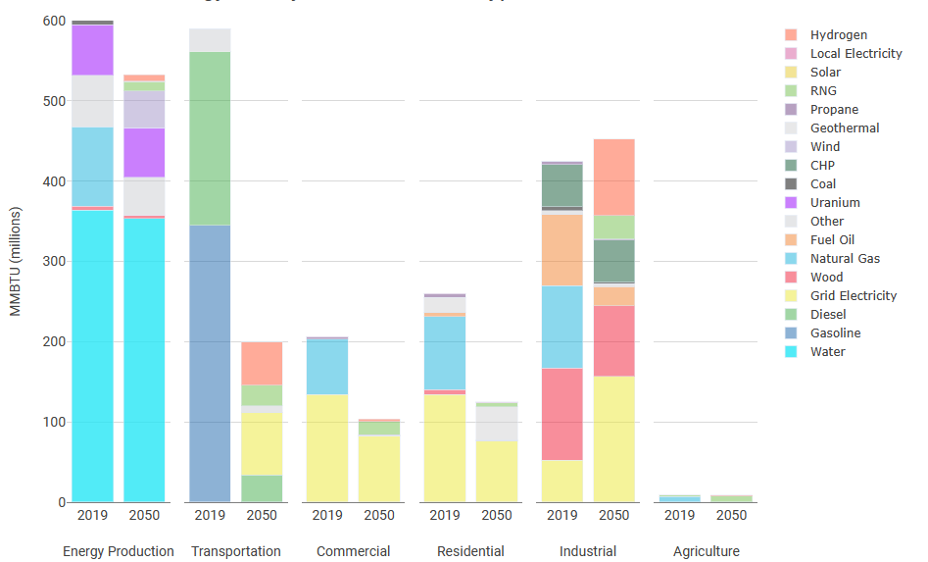
Energy Use by Sector and Fuel
Alternative Fuels
Hydrogen and RNG consumption
Hydrogen and RNG in Commercial vehicles

Slide 35
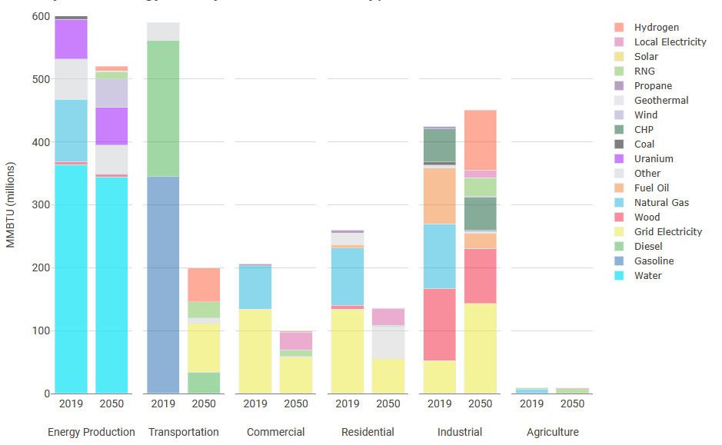
Energy Use by Sector and Fuel
Hybrid
Hydrogen and RNG production
Hydrogen and RNG in Commercial vehicles
Rooftop solar

Slide 36
Decarbonization Scenario Q&A

Slide 37
Supply & Demand

Slide 38
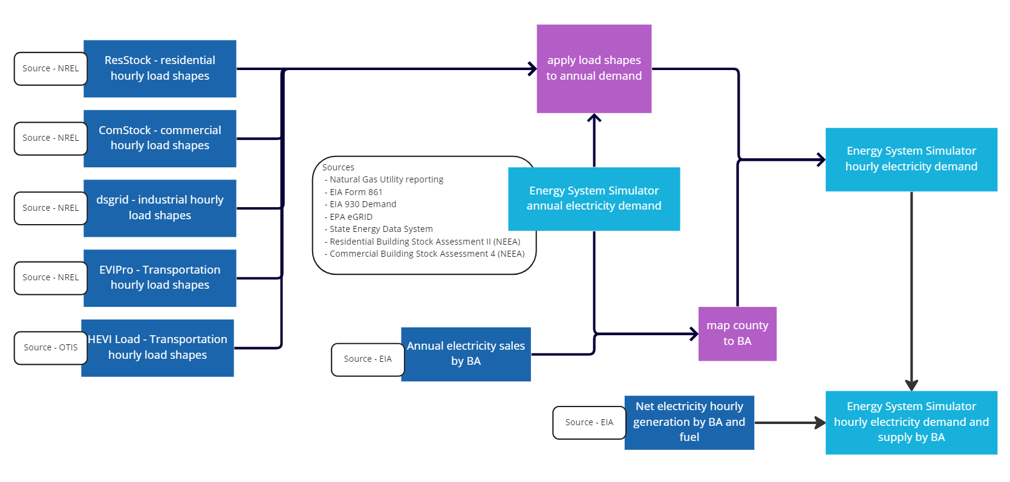
Hourly Demand Calibration
Notes:
NREL - National Renewable Energy Laboratory
EIA - Energy Information Administration
OTIS - US department of energy office of scientific and technical information
ESS - Energy System Simulator

Slide 39
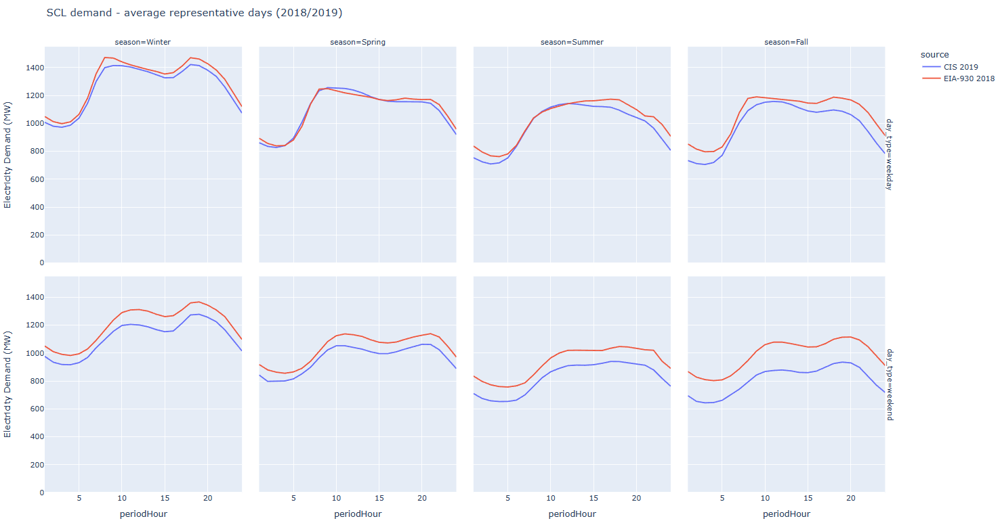
Hourly Demand Calibration
weekday
weekend

Slide 40
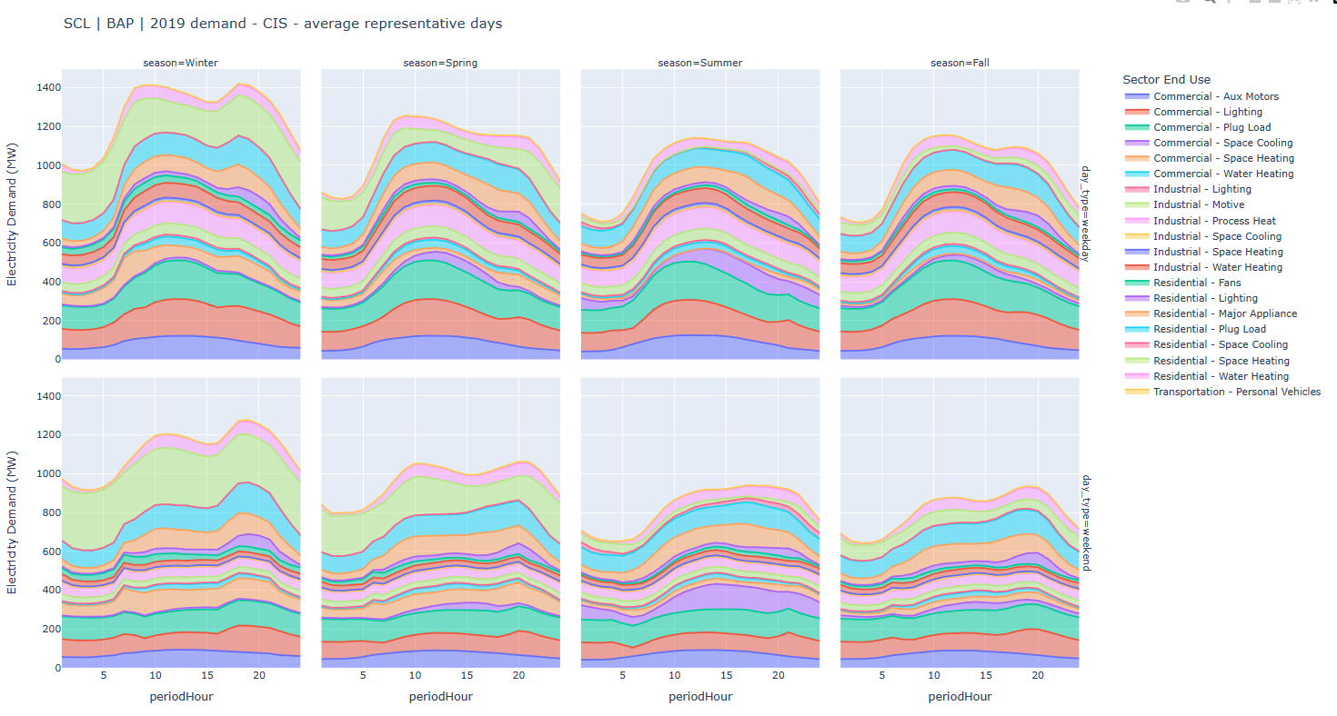
Hourly Demand Calibration
weekday
weekend

Slide 41
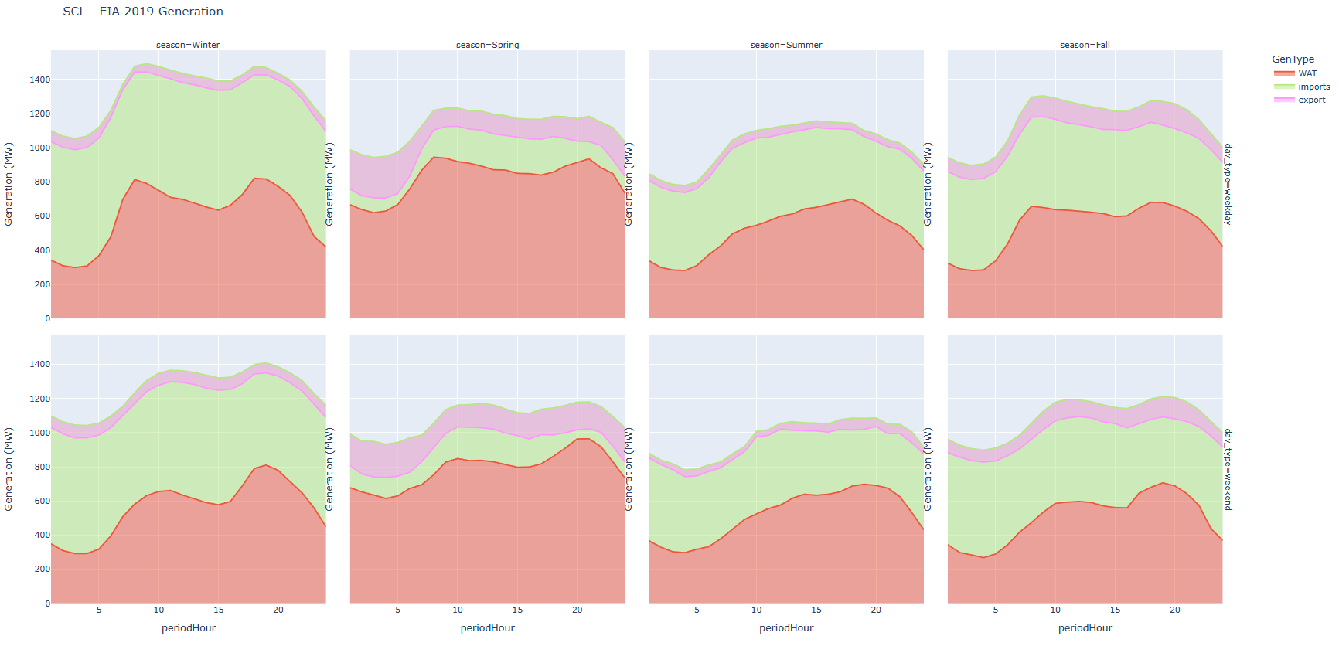
Supply

Slide 42
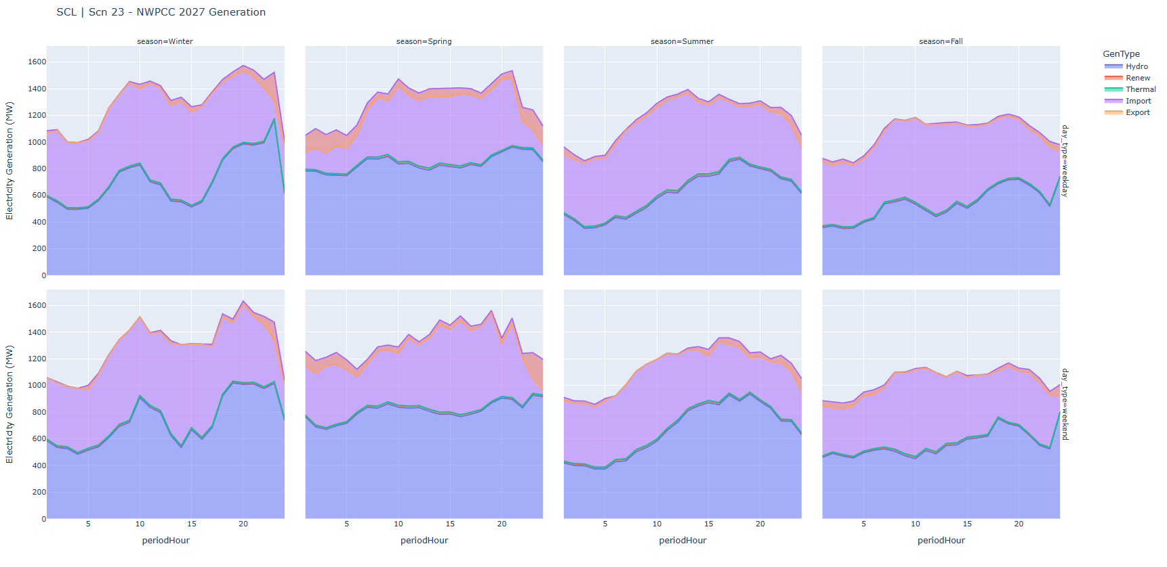
Supply

Slide 43
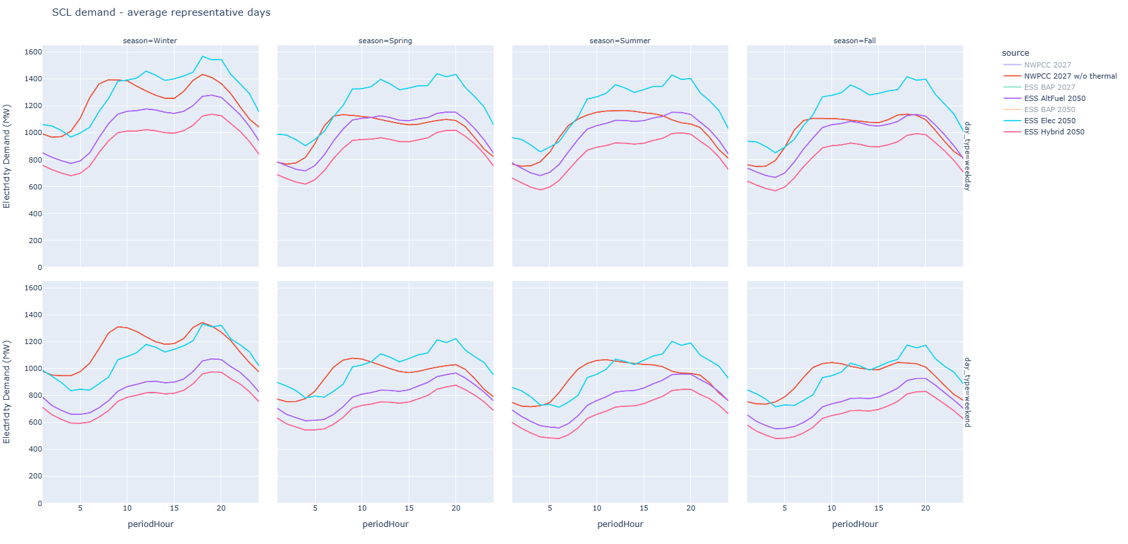
Demand Projections
Gap
weekday
weekend

Slide 44
Supply & Demand Q&A

Slide 45
Feedback Lab
Two scenarios proposed
Scenario 1 In State Constrained | Scenario 2 Imports Constrained
Defined in state capacity | Defined imports
Residual demand is met by imports | Residual demand is met by in state generation
Are we exploring the correct boundaries?
Is there anything missing?

Slide 46
Feedback Lab
Sources
Clean Energy Implementation and Action Plans
State Energy Strategy (Washington Department of Commerce)
Northwest Power and Conservation Council (NWPCC)
Resource Adequacy in the Pacific Northwest (E3 Study)
National Renewable Energy Laboratory (NREL) Research Studies
Givens
Peak temperature (short and long term) events will be evaluated for all scenarios
Resource adequacy implications will be evaluated for all scenarios
Financial considerations will be included for all scenarios
Equity considerations will be included for all scenarios

Slide 47
Feedback Lab
Scenario 1 | Scenario 2 | Siting and Distribution | Equity, Co-benefits, and Co-harms
In-state fuel production capacity | Out of state fuel production capacity | Implementation considerations | Considerations
Potential for exports | Potential for imports | How to address opportunities and constraints | Indicators
Opportunities and constraints | Opportunities and constraints

Slide 48
Appendix

Slide 49
Miro Board

Slide 50
 | Scenario 1 | Scenario 2
Resource | In-state Production and Exports - Capacity Potential (opportunities and constraints) | Out-of-state production and Imports - Capacity Potential (opportunities and constraints) | Siting and Distribution Implementation Considerations (based on opportunities and constraints) | Equity, Co-benefits, and Co-harms
Solar | Existing in-state solar capacity continues through 2050 Add 18 GW of in-state PV solar (a combination of 9 GW rooftop and 9 of utility scale) by 2050 Excess in-state generation used when available to produce alternative fuels and charge batteries | Build on existing utility scale solar in base year (2019) New rooftop solar additions are only as required by Building Code Inter-state transmission is expanded and Western Energy Imbalance Market moves to Day-Ahead Market model, allowing more imports than currently Import up to 15,000 GWh of solar electricity annually from BAs in Arizona, California, Nevada, New Mexico, and Utah by 2050 | All new commercial construction over 10,000 square feet equipped with rooftop solar, scaled to roof size and up to 100kW generating capacity Net-metering customers generate 4% of each utility's peak 1996 electricity demand by 2030 Address permitting process reforms and long timelines for siting and development Coordination with Tribes and local and Federal land managers Fully leverage investment incentives and tax credits from Infrastructure Investment and Jobs Act and Inflation Reduction Act | Considerations - Impacts and benefits to Tribal communities - Impacts and benefits to low-income communities - Impacts and benefits to rural communities - Co-location of agriculture, pollinator habitat, and solar PV - Operational lifespan of PV and recycling Pairing systems with battery storage for improved community and system resilience Indicators - Rooftop solar capacity per capita per county - Energy burden - Average annual energy expenditures compared to median household income - Costs of solar installation - Jobs created - New sectors and industries stimulated

Slide 51
 | Scenario 1 | Scenario 2
Resource | In-state Production and Exports - Capacity Potential (opportunities and constraints) | Out-of-state production and Imports - Capacity Potential (opportunities and constraints) | Siting and Distribution Implementation Considerations (based on opportunities and constraints) | Equity, Co-benefits, and Co-harms
Wind | Existing in-state wind capacity continues through 2050 Existing wind imports continue through 2050 but no new imports added Add 10 GW offshore wind and 7 GW of onshore wind by 2050 | Inter-state transmission is expanded and Western Energy Imbalance Market moves to Day-Ahead Market model, allowing more imports than currently Import up to 79,000 GWh of wind power from BAs in Montana, Colorado, New Mexico, and Wyoming | Address permitting process reforms and long timelines for siting and development Identification of least conflict areas for renewable siting in Columbia River Basin Include wind-based net metering projects up to 100 kW as enabled by state legislation Coordination with Tribes and local and Federal land managers Fully leverage investment incentives and tax credits from Infrastructure Investment and Jobs Act and Inflation Reduction Act | Considerations - Impacts and benefits to Tribal communities - Impacts and benefits to low-income communities - Impacts and benefits to rural communities - Co-location of agriculture, pollinator habitat, and wind turbines - Operational lifespan of turbines and recycling - Pairing systems with battery storage for improved community and system resilience - Impacts on migratory species and environmental quality - Potential conflicts with other marine uses and ocean environmental quality Indicators - Energy burden - Average annual energy expenditures compared to median household income - Jobs created - New sectors and industries stimulated

Slide 52
 | Scenario 1 | Scenario 2
Resource | In-state Production and Exports - Capacity Potential (opportunities and constraints) | Out-of-state production and Imports - Capacity Potential (opportunities and constraints) | Siting and Distribution Implementation Considerations (based on opportunities and constraints) | Equity, Co-benefits, and Co-harms
Hydro | Existing hydroelectric capacity serving Washington to remain at 2019 levels (22,000 MW capacity) No new additional hydroelectric capacity added Implement planned improvements and expansions of existing capacity Existing Bonneville Power Administration contracts with WA utilities renewed at same levels in 2028 | Maintain hydropower range of Federal Columbia River Power System of 10,000 - 15,000 average MW (35,000 MW capacity) Excess hydro generation sold or spilled (water is released) Existing Bonneville Power Administration contracts renewed on same terms in 2028 Use imported hydropower as flexible energy option during times of higher hydro output and lower renewable output elsewhere in the West | Potential removal of Lower Snake River dams which currently account for 3,033 MW hydro capacity, producing up to 900 average MW | Considerations - Impacts and benefits to Tribal communities - Impacts and benefits to rural communities - Operational lifespan of existing hydroelectric plants - Opportunities for expanding or improving existing hydroelectric generators - Impacts on migratory species and environmental quality due to fluctuating river flows if hydro is increasingly used as a flexible resource - Balance of competing water uses for energy, recreation, food and water source Indicators - Energy burden - Average annual energy expenditures compared to median household income - Jobs created

Slide 53
 | Scenario 1 | Scenario 2
Resource | In-state Production and Exports - Capacity Potential (opportunities and constraints) | Out-of-state production and Imports - Capacity Potential (opportunities and constraints) | Siting and Distribution Implementation Considerations (based on opportunities and constraints) | Equity, Co-benefits, and Co-harms
Geothermal | Ramp up installation of enhanced geothermal systems for space conditioning to no more than 71 GW by 2050 | Continue imports of conventional geothermal power at current rates. Mostly sourced from California. | Deploy enhanced geothermal by replacing existing gas infrastructure with neighborhood or block-level networks of ground-source heat exchangers, i.e. GeoGrids Technical capacity for high-temp conventional geothermal is approximately 300 MW along southern Cascades, however quite limited by rainfall, snow, and dense forests Leverage higher capacity for low-temp conventional geothermal in Central and Eastern Washington, building on existing use for heating buildings SB 5470 passed in 2017 will significantly improve the state's process for getting permission to explore geothermal resources Conventional geothermal capacity in other states is likely near maximum utilization | Considerations - Impacts and benefits to Tribal communities - Impacts and benefits to low-income communities - Impacts and benefits to rural communities - Co-location of agriculture, pollinator habitat, and solar PV - Operational lifespan of PV and recycling - Capital and operational costs compared to other technologies Indicators - Energy burden - Average annual energy expenditures compared to median household income - Costs of geothermal installation - Jobs created - New sectors and industries stimulated

Slide 54
 | Scenario 1 | Scenario 2
Resource | In-state Production and Exports - Capacity Potential (opportunities and constraints) | Out-of-state production and Imports - Capacity Potential (opportunities and constraints) | Siting and Distribution Implementation Considerations (based on opportunities and constraints) | Equity, Co-benefits, and Co-harms
Energy Storage | Continue to use existing 8 MW battery storage capacity Add up to 1.5 GW battery storage in-state by 2050 | Add up to 4.65 GW pumped hydro storage across Northwest Power Pool region by 2030 Draw on battery storage from rest of Western Interconnection (proportion of up to 190 GW for entire uS) | Existing local zoning and building regulations may not address these kinds of emerging technologies, leading to siting delays Reduced need for additional generating facilities and transmission | Considerations - Duration of battery storage and implications for resilience during extended power outages - Impacts on streamflow and fish and wildlife - Operational lifespan of batteries and recycling Indicators - Jobs created - New sectors and industries stimulated - Opportunities for innovation

Slide 55
 | Scenario 1 | Scenario 2
Resource | In-state Production and Exports - Capacity Potential (opportunities and constraints) | Out-of-state production and Imports - Capacity Potential (opportunities and constraints) | Siting and Distribution Implementation Considerations (based on opportunities and constraints) | Equity, Co-benefits, and Co-harms
Hydrogen | Produce up to 117 tBTU hydrogen in-state using hydro resources when supply outpaces demand Douglas County PUD hydrogen production plant operates through 2050 producing 735 tons per year (~82 tBtu) on average | Import all hydrogen except for what is produced at Douglas County PUD and Centralia | Existing local zoning and building regulations may not address these kinds of emerging technologies Gas utility infrastructure would need to be retrofitted to include higher blend of hydrogen in pipes Compressing hydrogen for distribution is energy-intensive Balance of uses for water for hydro power for green hydrogen production vs. for recreation, wildlife and Tribal resources Washington could be a site for a hydrogen hub as funded in the Infrastructure Investment and Jobs Act | Considerations - Impacts and benefits to Tribal communities - Impacts and benefits to low-income communities - Impacts and benefits to rural communities - Potential leakage rates of hydrogen - Safety and flammability - Global warming potential of hydrogen Indicators - Hydrogen capacity per capita per county - Average annual energy expenditures compared to median household income - Costs of upgrades to existing gas infrastructure - Jobs created - New sectors and industries stimulated

Slide 56
 | Scenario 1 | Scenario 2
Resource | In-state Production and Exports - Capacity Potential (opportunities and constraints) | Out-of-state production and Imports - Capacity Potential (opportunities and constraints) | Siting and Distribution Implementation Considerations (based on opportunities and constraints) | Equity, Co-benefits, and Co-harms
Renewable Natural Gas (RNG) and Synthetic Methane | Sufficient in-state production to provide 6% of RNG demand in-state by 2050 Build on existing in-state production of RNG at landfills and wastewater treatment plants, accounting for 1.3% of current fossil gas consumption Near term RNG projects produce 5.4 tBTU/yr Medium term RNG projects produce an additional 5.7 tBTU/yr Rely on imported RNG and synthetic methane for remaining demand | Import all available RNG and synthetic methane, up to 87.5 tBTU available annually by 2040 Based on US supply of RNG projected to be 3,750 tBTU/yr by 2040 | Use existing natural gas distribution and transmission (pipeline) networks when possible Potential sources of RNG: landfills, wastewater treatment plants, dairy digesters, food waste digesters Production of small volumes at distributed locations and connection to pipelines is cost-intensive Public opposition from communities neighboring projects dealing with organic waste Synthetic methane production is capital intensive but can be co-located with carbon capture | Considerations Impacts and benefits to Tribal communities Impacts and benefits to low-income communities Impacts and benefits to rural communities Impacts of natural gas use in stoves on indoor air quality Indicators Average annual energy expenditures compared to median household income Jobs created New sectors and industries stimulated Premature deaths from air pollution

Slide 57
 | Scenario 1 | Scenario 2
Resource | In-state Production and Exports - Capacity Potential (opportunities and constraints) | Out-of-state production and Imports - Capacity Potential (opportunities and constraints) | Siting and Distribution Implementation Considerations (based on opportunities and constraints) | Equity, Co-benefits, and Co-harms
Natural (Fossil) Gas | In-state production of natural gas fuel continues to be zero through 2050 Existing 4,144 MW capacity of natural gas baseload and peaking plants continues to serve WA load until 2030, only up to 20% of demand Plants go offline during currently scheduled outages and planned retirements | Import all fossil natural gas to meet fuel demand until 2050. Primarily imported from Canada. | Strategies for addressing the costs of unused infrastructure that is no longer useful (stranded assets) | Considerations - Impacts of natural gas use in stoves on indoor air quality - Impacts of natural gas power plants on rural communities, low-income communities, and Tribal communities - Impacts of natural gas power plants on communities of color Indicators - Average annual energy expenditures compared to median household income - Jobs lost or maintained - Opportunities for economic and social innovation - Premature deaths from air pollution

Slide 58
 | Scenario 1 | Scenario 2
Resource | In-state Production and Exports - Capacity Potential (opportunities and constraints) | Out-of-state production and Imports - Capacity Potential (opportunities and constraints) | Siting and Distribution Implementation Considerations (based on opportunities and constraints) | Equity, Co-benefits, and Co-harms
Coal | Centralia plant closes by 2025, production shifts to producing 40,000 tons of green hydrogen per year | Colstrip (Montana) no longer serving Washington customers by 2025 | No new coal development in-state, likely very limited and phasing out in other parts of the Western Interconnection | Considerations - Impacts on outdoor air quality - Impacts on rural communities, low-income communities, and Tribal communities Indicators - Jobs lost - Opportunities for economic and social innovation (ex. plant conversion, "steel for fuel") - Premature deaths from air pollution

Slide 59
 | Scenario 1 | Scenario 2
Resource | In-state Production and Exports - Capacity Potential (opportunities and constraints) | Out-of-state production and Imports - Capacity Potential (opportunities and constraints) | Siting and Distribution Implementation Considerations (based on opportunities and constraints) | Equity, Co-benefits, and Co-harms
Nuclear | Additional 320 MW capacity added in 2027 (Hanford Nuclear Reservation Site) Existing supply of 1,200 MW from existing Columbia River Generation site continues Exports of nuclear power are essentially zero New small modular reactors could come online in future years, based on progress of Hanford site | Imports of nuclear are essentially zero No additional nuclear planned in the region Closure of Diablo Canyon nuclear power generating facility (California) by 2025 | Siting and permitting is contentious and lengthy process Public opposition to new and existing nuclear | Considerations - Impacts on water quality - Impacts on rural communities, low-income communities, and Tribal communities Indicators - Jobs generated or maintained - Opportunities for economic and social innovation

Slide 60
Engagement Review

Slide 61


Engagement in Climate Action Planning
E.
Plan
Financial + Economic Analysis
Health +
Equity
Data
PE
Briefings
Scenarios
Pathways
Iteration + Adaptive Management
Active Engagement Period

Slide 62
Engagement Approach
Overall project will be set involve/collaborate (see next slide) for influence on the decision.
We will ensure a transparent and accessible engagement process.
We will use diverse techniques to effectively reach diverse stakeholders across the state.
We will gather input on the social, economic, and equity impacts of decarbonization actions.
We will design engagements to facilitate collaboration, rather than polarization.

Slide 63
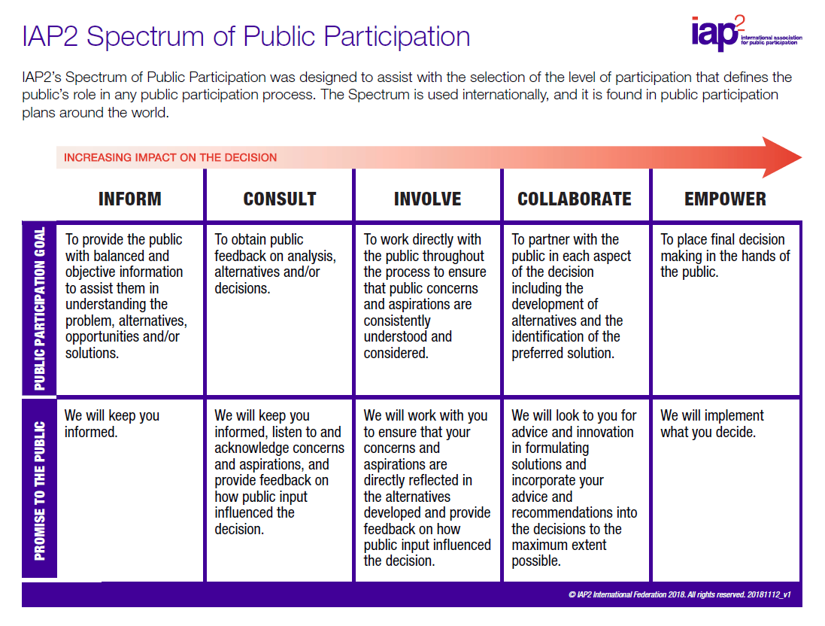

Slide 64
Scenarios Parameters

Slide 65
BAP Actions
Action
Clean Fuel Standard
Advancing Green Transportation - personal
Advancing Green Transportation - commercial
State Energy Code - Residential
State Energy Code - Commercial
Move Ahead Washington
Clean Buildings Performance Standard - Tier 1
State Energy Code - Apt
Renewable Hydrogen

Slide 66
Common Actions - Both Scenarios
Action | Specification
Increase density of development in urban zones | Fraction of single new builds to be reduced to 25% of new buildings in counties with high urban density by 2040, decrease in personal use vehicle miles travelled
Deep retrofits in the building stock | Retrofit 95% of existing buildings by 2040 to achieve a 50% reduction in space heating/cooling and a 40% reduction other non water heating energy use
Increase transit ridership | Triple transit ridership in urban centers by 2040
Decrease freight vehicle miles travelled | Decrease vehicle miles travelled by 15% by 2050
Mode Shift to cycling | Transfer 10% of personal use vehicle trips to electric micro-mobility (e.g., e-bike/e-scooter) in urban counties by 2035
Efficiency improvements in industry | Improve the energy efficiency of industrial facilities to achieve a 50% reduction in energy use by 2050
Marine passenger electrification | Passenger ferries 100% electric by 2040

Slide 67
Electrification - Demand Side Actions
Action | Specification
Heat pumps residential space conditioning | 95% of new sales for existing buildings are electric heat pumps by 2040
Heat pumps residential water heating | 95% of new sales for existing buildings are electric heat pumps by 2040
Heat pumps commercial space conditioning | 95% of new sales for existing buildings are electric heat pumps by 2040
Heat pumps commercial water heating | 50% of new sales for existing buildings are electric heat pumps by 2040
Zero emission commercial use vehicles | Percentage of new sales by 2035 - 100% Classes 2b–3 trucks electric (vans, medium pickup trucks) - 90% Classes 4–8 trucks electric (delivery trucks, delivery/service vans, lighter truck tractors, bucket trucks) - 80% Class 8 truck tractors electric
Electrification of some industrial processes | Deploy electricity in industries - replace 55% fossil fuels with electricity by 2050
Enable distributed energy resources | 20 TWh of rooftop solar PV generation by 2035
Enhance energy storage | Add storage capability to 25% of residential non-apartment building stock by 2035, assume each storage unit is specified to 14 kWh

Slide 68
Alternative Fuels - Demand Side Actions
Action | Specification
Heat pumps in residential space conditioning | 95% of new sales for existing buildings are electric & natural gas heat pumps by 2040
Heat pumps in residential water heating | 95% of new sales for existing buildings are electric & natural gas heat pumps by 2040
Heat pumps commercial space conditioning | 95% of new sales for existing buildings are electric and natural gas heat pumps by 2040
Heat pumps commercial water heating | 50% of new sales for existing buildings are electric and natural gas heat pumps by 2040
Adoption of hydrogen into residential homes | Deploy clean hydrogen fuel cells for homes - 5% of homes will have hydrogen fuel cell by 2030
Zero emission commercial use vehicles | Percentage of new sales by 2035 - 100% Classes 2b–3 trucks - 80% EV, 20% ZEV (vans, medium pickup trucks) - 90% Classes 4–8 trucks - 50% EV, 50% ZEV (delivery trucks, delivery/service vans, lighter truck tractors, bucket trucks) - 80% Class 8 truck tractors - 20% EV, 80% ZEV
Hydrogen and RNG into industrial processes | Deploy green hydrogen and RNG in industries - 70% Hydrogen/RNG adoption by 2050

Slide 69
Alternative Fuels - Demand Side Actions
Action | Specification
Clean hydrogen in the natural gas grid | New round of standards for appliances and equipment beyond those codified in 2021 - 15% hydrogen injected into the natural gas distribution system by 2035
RNG in the natural gas grid | Use full RNG potential of 87.5 tBTU by 2050
In-state production of RNG | Produce sufficient RNG to provide 6% of RNG demand within the state by 2050
In-state production of clean hydrogen | Produce sufficient hydrogen to provide 50% of hydrogen demand within the state

Slide 70
Hybrid - Demand Side Actions
Action | Specification
Heat pumps residential space conditioning | 95% of new sales for existing buildings are electric heat pumps by 2040
Heat pumps residential water heating | 95% of new sales for existing buildings are electric heat pumps by 2040
Heat pumps commercial space conditioning | 95% of new sales for existing buildings are electric heat pumps by 2040
Heat pumps commercial water heating | 50% of new sales for existing buildings are electric heat pumps by 2040
Zero emission commercial use vehicles | Percentage of new sales by 2035 - 100% Classes 2b–3 trucks - 80% EV, 20% ZEV (vans, medium pickup trucks) - 90% Classes 4–8 trucks - 50% EV, 50% ZEV (delivery trucks, delivery/service vans, lighter truck tractors, bucket trucks) - 80% Class 8 truck tractors - 20% EV, 80% ZEV
Hydrogen and RNG into industrial processes | Deploy green hydrogen and RNG in industries - 70% Hydrogen/RNG adoption by 2050

Slide 71
Hybrid - Demand Side Actions
Action | Specification
Enable distributed energy resources | 20 TWh of rooftop solar PV generation by 2035
Enhance energy storage | Add storage capability to 25% of residential non-apartment building stock by 2035, assume each storage unit is specified to 14 kWh
Clean hydrogen in the natural gas grid | New round of standards for appliances and equipment beyond those codified in 2021 - 15% hydrogen injected into the natural gas distribution system by 2035
RNG in the natural gas grid | Use full RNG potential of 87.5 tBTU by 2050
In-state production of RNG | Produce sufficient RNG to provide 6% of RNG demand within the state
In-state production of clean hydrogen | Produce sufficient hydrogen to provide 50% of hydrogen demand within the state

